Slide 1
Enhancing Structural Test with Probabilistic Functional Information the first report
Advisor: Dworak, Jennifer(jdworak@smu.edu)
Zhang, Fanchen graduate Research Assistant (fzhang@smu.edu)
Thornton, Micah undergraduate Research Assistant (mathornton@smu.edu)

Slide 2
Cell-aware fault Testing flow
Tools
Input
Output
Mentor Graphic Tessent User Defined Fault Models(UDFM)
Define
Cell-aware Fault
Cell-aware faults file described by UDFM format
Cell-aware faults
Mentor Graphic Tessent
Original circuit
Insert
Scan Chain
Circuit with Scan Chain
Test procedure file
Generate
Test Timing Template
(ATPG for Stuck-at)
Scan Chain test timing template
(it is the ATPG patterns for Stuck-at)
Mentor Graphic Tessent
Original circuit
Synopsys Verilog Complier Simulator (VCS)
Synopsys Verilog Complier Simulator (VCS)
Generate
Good-States
Good States
Mentor Graphic Tessent
Cell-Aware faults
Circuit with Scan Chain
Test Procedure file
Scan Chain test timing template
Good States
Cell-aware Fault Simulate
Fault simulation file
Fault Detected Dictionary
Notes:
Explain the testing flow, it has 5 steps, the last two steps are most important. The third step(Generate Test Timing Template) is in order to obtaining Scan Chain test timing template ( describe how the scan chain work) and add it into our good-state patterns to make Tessent work, in following slides I explain it in detail.

Slide 3
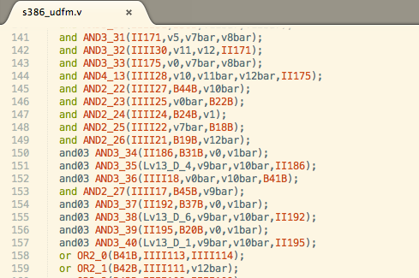
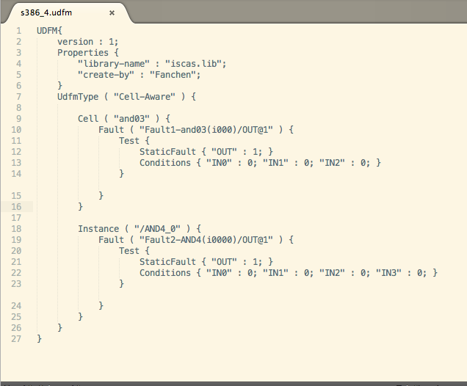
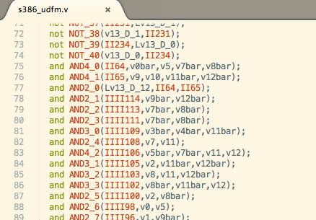
Define Cell-aware faults
S386 Cell-aware fault defined in UDFM format
S386 circuit modified in UDFM format
Modified those cells by using library’s cell
Maps a set of defined faults to a specified library cell
Maps a set of defined faults to a specified instance
Keep this cell without modified
Cell-aware faults are defined:
s386 UDFM file
s820 UDFM file
Notes:
UDFM support three fault models defined. Here we use two: library cell and instance, Because we pay attention on Cell-aware fault, the Module model we did not employ. This slide shows how UDFM define and work on circuit’s Verilog file

Slide 4
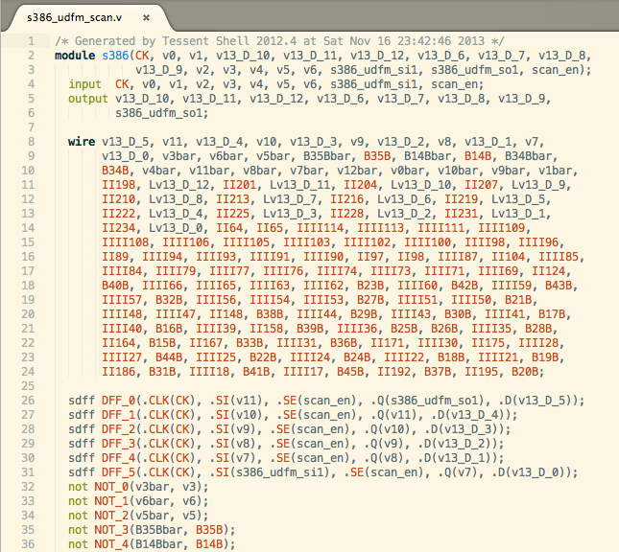
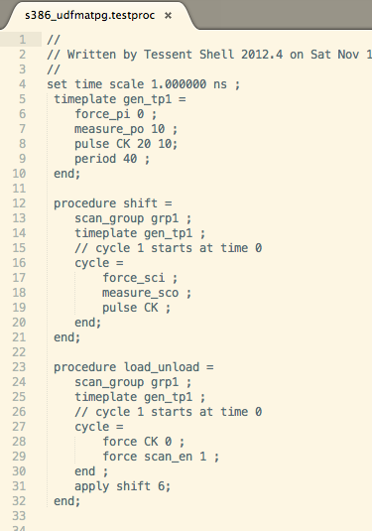
Insert Scan-chain
In this step, we obtained the circuit with scan chain and a test procedure file for testing.
A circuit with a Scan Chain
S386 inserted a scan-chain
Test procedure
Combinational Logic
CLK
D
D
D
Scan_in
Scan_out
DFFs with a Scan_Chain
Q
Q
Q
Combinational Logic
The test procedure file defines timing for scan chain load, shift and unload.
Circuits with Scan Chain:
s328_ScanChain
s820_ScanChain
Test procedure files:
s328_testproc
S820_testproc
Notes:
This slide show how Scan-chain work on circuit’s Verilog and what does timing file for Scan-chain file look like. I think conventioneers are experts on testing area. Therefore I did not pay more attention on this slide and we don’t have to explain it in deeply.

Slide 5
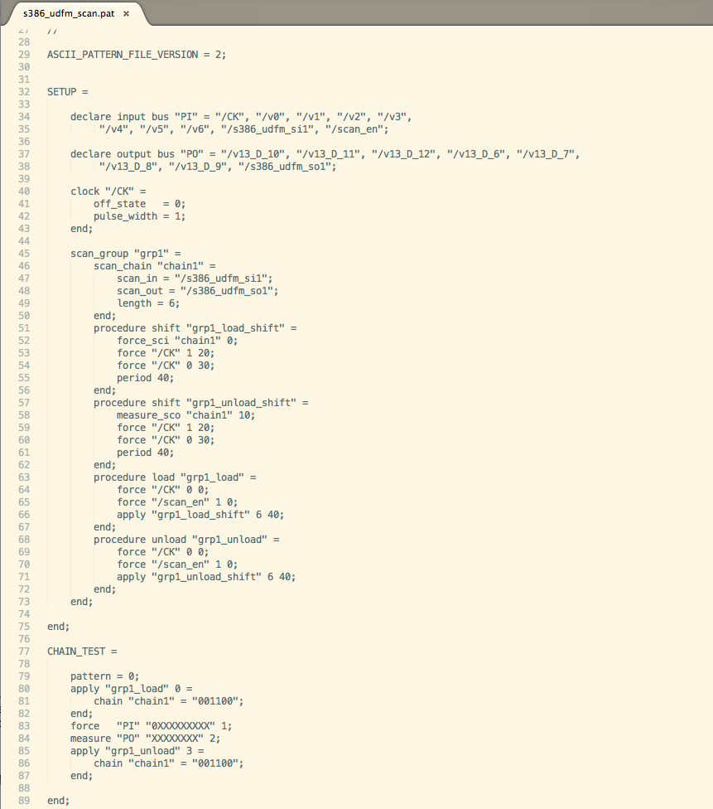
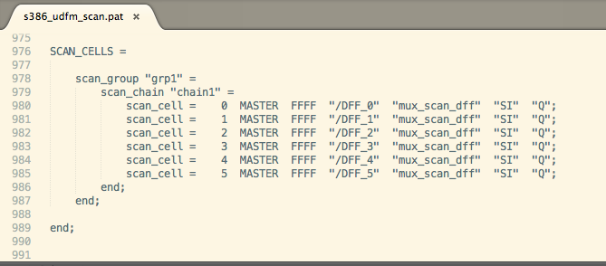
Generate Test Timing Template
In this step, by generating ATPG patterns for stuck-at faults,
we extracted testing header and tail for adding our Good-State testing file to make Tessent read and simulate
we also used ATPG patterns for stuck-at faults to test Cell-aware faults to compare our Good-State patterns effects
Header of s386 ATPG patterns file for S-at
Tail of s386 ATPG patterns file for S-at
Declare input, output and clock
Timing of testing procedure
In the tail, it describes the Scan-Chain
Scan-Chain test
ATPG patterns for Stuck-at fault files:
S328_atpg_sat_patterns
S820_atpg_sat_patterns
In the header, it declares input, output clock pins and describes the timing procedure for Scan-Chain load, shift and unload. Also it generates a pattern to test the Scan-chain
Notes:
Here I explain the reason why we have “Generate Test Timing Template” step. It has two reasons as showed above. This way is a easy way to let Tesssent create timing file for scan-chain. If we want to define the timing file, I think we also can do it but it not good way to do in the current circumstances demand

Slide 6
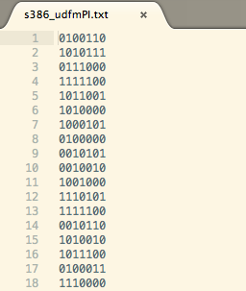
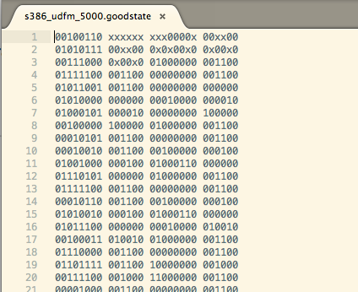
Generate the Good-State patterns: flow chart
Tools
Input
Output
… …
Creates random patterns
Simulate these patterns by VCS
Grab Good-State patterns
Perl script
None
Random input patterns
Generate
Good-States
VCS
Test Bench of Verilog
Random input patterns
Good-State Patterns
… …
s386 Random input patterns
s386 Good-State patterns
Input
Q
Output
D
Random input patterns:
s328_PI
s820_PI
Test Bench:
s328_tb
s820_tb
Good-State patterns:
s328_goodstate
s820_goodstate
The first three or more Good-State will be dropped because they are unstable
All pins’ order are same with original circuit
All pins’ order are same with Scan-Chain circuit. The input patterns include clock pin(the first one)
Notes:
This slide show three detail steps in Generate Good-states. Actually the second and third step are worked together. The reason I separate it into two is I want to present it clearly. Here need to notice the pins’ order are different in input patterns and Good-state patterns, the reason is Good-state patterns is for simulating scan-chain circuit.

Slide 7
Generate the Good-State patterns: timing of Good-Sate
Clock period = 20 time unit
Good-State 1
Good-State 2
… …
0
2
18
22
38
40
20
Clock
Input 1
Input 2
input
Output
input
Output
Output 1
Output 2
… …
Time Frame Expansion
Combinational Logic
D 1
Combinational Logic
D 2
D
DFF
Q
D
DFF
Q
Q
×××
Q 1
Q 2
… …
Input:
2nd Random pattern
Grab: Good-State 2
2nd input Random pattern, for state 2 PI
Q value, for state 2 Chain Load
D value, for state 2 Chain Unload
Output, for state 2 PO
Input:
1st Random pattern
Grab: Good-State1
1st input Random pattern, for state 1 PI
Q value, for state 1 Chain Load
D value, for state 1 Chain Unload
Output, for state 1 PO
Notes:
Try to use time frame expansion to explain how did we grab the good states

Slide 8
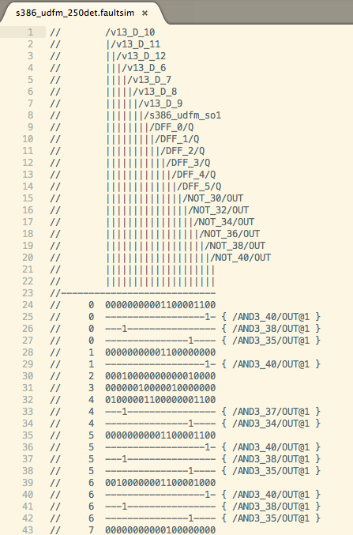
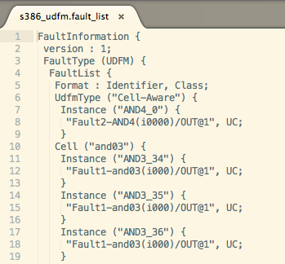
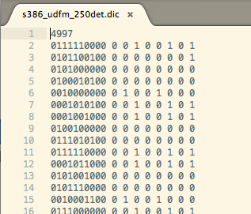
Cell-aware Fault Simulate
Tools
Input
Output
… …
Creates Cell-Aware simulating patterns into multiple files, each file has 20 patterns
Insert Cell-Aware fault and simulates
Concatenate faultsim_files into one fault_sim file
Generates detected dictionary
Perl script
Good-State Patterns
Header and tail of ATPG patterns file
Good-State simulating file
Cell-aware Fault Simulate
Tessent by using UDFM
UDFM file
Scan Chain circuit
Good-State simulating file
Fautsim_files
Faut list
Note: Since UDFM does not support multiple detection, we have to separate patterns into multiple files to simulate multiple times, and concatenate faultsim_files into one file
Perl script
Fautsim_files
Fautsim_file
Perl script
Fautsim_files
Faut list
Good-State file
fault_det_dic
s386 fault_sim file
s386 fault list file
s386 fault_det_dic file
Good-State simulation files:
s328_sim_pat
s820_sim_pat
fault_sim files:
s328_faultsim
s820_faultsim
fault_list files:
s328_fault_list
s820_fault_list
fault detected dictionary:
s328_det_dic
s820_det_dic
sim_patterns
each fault in fault list order
Notes:
Here because I use Yiwen code to generate fault detected dictionary, it require all sim-patterns in one file not into multiple files, there is one more step between step3 and step4 that Creates Cell-Aware simulating patterns into one file. This is code caused one more step, I don’t want to show it up. I can combine it into step 4 in the future work.

Slide 9
Evaluating: Comparison of Detected for Cell-aware of ATPG, Stuck-at of APTG and Good-State patterns
Good-State patterns are effectively to detect those faults affect the circuit function. That means we will focus on these faults and attempt to process Good-State patterns to make them more effective.
s386 Cell-aware fault detected (8 faults)
 | /AND4_0/OUT | /AND3_34/OUT | /AND3_35/OUT | /AND3_36/OUT | /AND3_37/OUT | /AND3_38/OUT | /AND3_39/OUT | /AND3_40/OUT
ATPG cell-aware | Y | Y | Y | Y | Y | Y | Y | Y
ATPG S-at | N | Y | Y | N | N | Y | Y | Y
Good-State | N | Y | Y | N | Y | Y | Y | Y
s820 Cell-aware fault detected (12 faults)
 | /AND4_9/ OUT | /NAND4_29/OUT | /NOR4_4/ OUT | /AND3_10/ OUT | /AND3_11/ OUT | /AND3_12/ OUT | /NAND3_3/OUT | /NAND3_4/OUT | /NAND3_5/OUT | /NOR3_9/ OUT | /NOR3_10/ OUT | /NOR3_11/ OUT
ATPG cell-aware | Y | Y | N (RE) | Y | N (RE) | Y | Y | Y | Y | Y | Y | Y
ATPG S-at | Y | Y | N | N | N | Y | Y | Y | Y | Y | Y | Y
Good-State | Y | Y | N | N | N | N | N | N | N | N | Y | Y
s38584 Cell-aware fault detected(12 faults)
 | /AND4_8/ OUT | /NAND4_28/ OUT | /NOR4_5/ OUT | /AND3_0/ OUT | /AND3_1/ OUT | /AND3_2/ OUT | /NAND3_0/ OUT | /NAND3_1/ OUT | /NAND3_2/OUT | /NOR3_0/ OUT | /NOR3_1/ OUT | /NOR3_2 /OUT
ATPG cell-aware | Y | Y | Y | Y | Y | Y | Y | Y | Y | Y | Y | Y
ATPG S-at | Y | Y | Y | Y | Y | Y | Y | Y | Y | Y | Y | Y
Good-State | Y | N | Y | Y | Y | Y | Y | Y | Y | N | Y | N
Note: All results of Good-State come from 100,000 number of patterns

Slide 10
Evaluating: Comparison of number of detected for S-at patterns, 5k Good-State and 10k Good-State patterns
With the size of circuit increasing, the number of detected for faults are decreased. Some faults are hard to be detected which are our future focus. ATPG for S-at faults patterns are also can detect some faults, we may combine the ATPG patterns with Good-State patterns to make testing more effectively.
s386 faults detected times S-at
s820 faults detected times S-at
s38584 faults detected times S-at
No. | 1 | 2 | 3 | 4
Fault | /AND4_0/ OUT | /AND3_34/ OUT | /AND3_35/ OUT | /AND3_36/OUT
80 PATs | 0 | 2 | 8 | 0
No. | 5 | 6 | 7 | 8
Fault | /AND3_37/OUT | /AND3_38/OUT | /AND3_39/OUT | /AND3_40/OUT
80 PATs | 2 | 8 | 2 | 9
No. | 1 | 2 | 3 | 4 | 5 | 6
Fault | /AND4_9/OUT | /NAND4_29/OUT | /NOR4_4/OUT | /AND3_10/OUT | /AND3_11/OUT | /AND3_12/OUT
115 PATs | 1 | 40 | 0 | 0 | 0 | 1
No. | 7 | 8 | 9 | 10 | 11 | 12
Fault | /NAND3_3/OUT | /NAND3_4/OUT | /NAND3_5/OUT | /NOR3_9/OUT | /NOR3_10/OUT | /NOR3_11/OUT
115 PATs | 4 | 3 | 5 | 1 | 1 | 2
No. | 1 | 2 | 3 | 4 | 5 | 6
Fault | /AND4_8/OUT | /NAND4_28/OUT | /NOR4_5/OUT | /AND3_0/OUT | /AND3_1/OUT | /AND3_2/OUT
205 PATs | 5 | 2 | 2 | 0 | 38 | 4
No. | 7 | 8 | 9 | 10 | 11 | 12
Fault | /NAND3_0/OUT | /NAND3_1/OUT | /NAND3_2/OUT | /NOR3_0/OUT | /NOR3_1/OUT | /NOR3_2/OUT
205 PATs | 19 | 11 | 12 | 15 | 46 | 7
s386 faults detected times G-S
s820 faults detected times G-S
s38584 faults detected times G-S
No. | 1 | 2 | 3 | 4
Fault | /AND4_0/OUT | /AND3_34/OUT | /AND3_35/OUT | /AND3_36/OUT
5k patterns | 0 | 175 | 1974 | 0
10k patterns | 0 | 354 | 3890 | 0
No. | 5 | 6 | 7 | 8
Fault | /AND3_37/OUT | /AND3_38/OUT | /AND3_39/OUT | /AND3_40/OUT
5k patterns | 175 | 1974 | 220 | 2124
10k patterns | 358 | 3890 | 454 | 4216
No. | 1 | 2 | 3 | 4 | 5 | 6
Fault | /AND4_9/OUT | /NAND4_29/OUT | /NOR4_4/OUT | /AND3_10/OUT | /AND3_11/OUT | /AND3_12/OUT
5k patterns | 22 | 2068 | 0 | 0 | 0 | 0
10k patterns | 45 | 4151 | 0 | 0 | 0 | 0
No. | 7 | 8 | 9 | 10 | 11 | 12
Fault | /NAND3_3/OUT | /NAND3_4/OUT | /NAND3_5/OUT | /NOR3_9/OUT | /NOR3_10/OUT | /NOR3_11/OUT
5k patterns | 0 | 0 | 0 | 0 | 56 | 34
10k pattern | 0 | 0 | 0 | 0 | 102 | 110
No. | 1 | 2 | 3 | 4 | 5 | 6
Fault | /AND4_8/OUT | /NAND4_28/OUT | /NOR4_5/OUT | /AND3_0/OUT | /AND3_1/OUT | /AND3_2/OUT
5k patterns | 192 | 0 | 163 | 1 | 1038 | 28
10k patterns | 351 | 0 | 335 | 4 | 2129 | 40
No. | 7 | 8 | 9 | 10 | 11 | 12
Fault | /NAND3_0/OUT | /NAND3_1/OUT | /NAND3_2/OUT | /NOR3_0/OUT | /NOR3_1/OUT | /NOR3_2/OUT
5k patterns | 423 | 403 | 0 | 0 | 829 | 0
10k patterns | 862 | 780 | 4 | 0 | 1585 | 0

Slide 11
Evaluating: Increase faults and Good-state patterns for s38584 benchmark based on 1st fault set
s38584 Cell-aware fault detected (1010 faults)
GATE | AND |  |  | NAND |  |  | OR |  |  | NOR |  |  | SUM
 | AND2 | AND3 | AND4 | NAND2 | NAND3 | NAND4 | OR2 | OR3 | OR4 | NOR2 | NOR3 | NOR4
Total number of gates | 4930 | 287 | 299 | 1618 | 236 | 272 | 2464 | 63 | 94 | 1063 | 105 | 17 | 11448
Total number of gates with fault | 100 | 200 | 200 | 50 | 75 | 75 | 80 | 50 | 80 | 30 | 60 | 10 | 1010
1st Fault set | i00/o1 | i000/o1 | i0000/o1 | i00/o0 | i000/o0 | i0000/o0 | i11/o0 | i111/o0 | i1111/o0 | i11/o1 | i111/o1 | i1111/o1
Number of faults detected
Faults coverage of detected
517
518
49.11%
50.30%
51.29%
486
485
496
496
508
508
48.12%
48.02%
49.11%
50.30%
51.19%
Number of faults detected for each kind of gate
Faults coverage for each kind of gate
1st Pat. Set
2nd
Pat. Set

Slide 12
Evaluating: Increase faults and Good-state patterns for s38584 benchmark based on 2nd faults set
s38584 Cell-aware fault detected (1010 faults)
GATE | AND |  |  | NAND |  |  | OR |  |  | NOR |  |  | SUM
 | AND2 | AND3 | AND4 | NAND2 | NAND3 | NAND4 | OR2 | OR3 | OR4 | NOR2 | NOR3 | NOR4
Total number of gates | 4930 | 287 | 299 | 1618 | 236 | 272 | 2464 | 63 | 94 | 1063 | 105 | 17 | 11448
Total number of gates with fault | 100 | 200 | 200 | 50 | 75 | 75 | 80 | 50 | 80 | 30 | 60 | 10 | 1010
2nd Fault set | i00/o1 | i100/o1 | i1001/o1 | i00/o0 | i100/o0 | i1001/o0 | i11/o0 | i110/o0 | i1100/o0 | i11/o1 | i110/o1 | i1100/o1
Number of faults detected
Faults coverage of detected
47.33%
48.91%
50.30%
51.58%
465
478
497
494
513
508
511
521
49.21%
50.79%
50.59%
46.04%
Number of faults detected for each kind of gate
Faults coverage for each kind of gate
1st Pat. Set
2nd
Pat. Set

Slide 13
Evaluating: Comparison of number of detected for S-at patterns and 40k Good-State patterns for s38584 benchmark
Number of faults detected
Faults coverage
527
538
518
508
524
53.27%
51.88%
521
52.18%
51.29%
50.30%
51.58%
S-at EMD_n=3 patterns V.S. 40k Good-State
Overall detected distribution for fault set
Color | Represent |  |  | Number of detected
 | S-at ATPG | Good-state patterns | Cell-aware APTG | 1st fault set | 2nd fault set
Green | N | N | Y | 23 | 26
Blue | N | Y | Y | 43 | 65
Yellow | Y | N/Y | Y | 527 | 508
1st fault set
2nd fault set
RE: redundant 413
TI: tied 4
RE: redundant 407
TI: tied 4
S-at EMD_n=7 patterns V.S. 40k Good-State
Overall detected distribution for fault set
Color | Represent |  |  | Number of detected
 | S-at ATPG | Good-state patterns | Cell-aware APTG | 1st fault set | 2nd fault set
Green | N | N | Y | 25 | 23
Blue | N | Y | Y | 30 | 52
Yellow | Y | N/Y | Y | 538 | 524
1st fault set
2nd fault set
RE: redundant 413
TI: tied 4
RE: redundant 407
TI: tied 4

Slide 14
Evaluating: Comparison of number of detected for S-at patterns and 40k Good-State patterns for s38584 benchmark
43 faults detected by Good-Sate but not ATPG S-at EMD n = 3 based on 1st faults set
65 faults detected by Good-Sate but not ATPG S-at EMD n = 3 based on 2nd faults set
30 faults detected by Good-Sate but not ATPG S-at EMD n = 7 based on 1st faults set
52 faults detected by Good-Sate but not ATPG S-at EMD n = 7 based on 2nd faults set

Slide 15
Conclusions & Next step work
Conclusions:
Cell-aware faults can be detected by UDFM model of Mentor Graphic
ATPG for S-at patterns detect Cell-aware fault
Good-state patterns detect Cell-aware fault
Good-State patterns detect Cell-aware fault
Can detect those faults affect the circuit function
Some faults are hard to be detected
Next step work:
Attempt to do experiment on Large circuit
ATPG for S-at patterns on Large circuit
Good-state patterns on Large circuit
Process Good-State patterns to make them more effective
Identify mandatory conditions
Identify hard faults
Find a way to process Good-State
Notes:
These are my thoughts for conclusion and next step work. Maybe you have better ideas you can tell me let me modify.

Slide 16
Q&A
Thank You!!!

